Slide 1
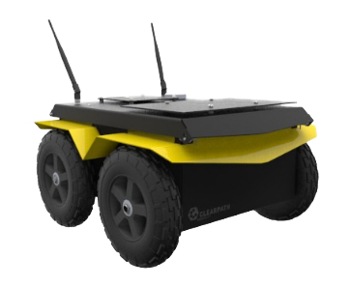
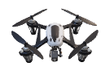
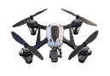
OpenAI Gym Interface
State Abstraction
Action Abstraction
Map
Primitives
Swarm Primitives
Building Location
Path
Planning
…
Formation
Control
Area
Coverage
…
Area …
Vehicle Model
Individual
Platoon Abstraction
Vehicle State
Sensor Model
Kinematics/
Dynamics
Query states
Execute actions
Bullet Physics Engine

